Slide 1
Course
AWS Cloud Practitioner
MaxCloud

Slide 2
09
Class
AWS Amplify
AWS AppSync
Amazon AppStream 2.0
Amazon WorkSpaces
AWS CloudFormation

Slide 3
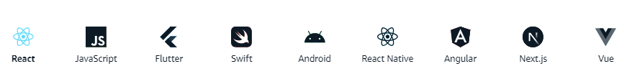
AWS Amplify
AWS Amplify provides libraries for popular web and mobile frameworks, like JavaScript, Flutter, Swift, and React.

Slide 4
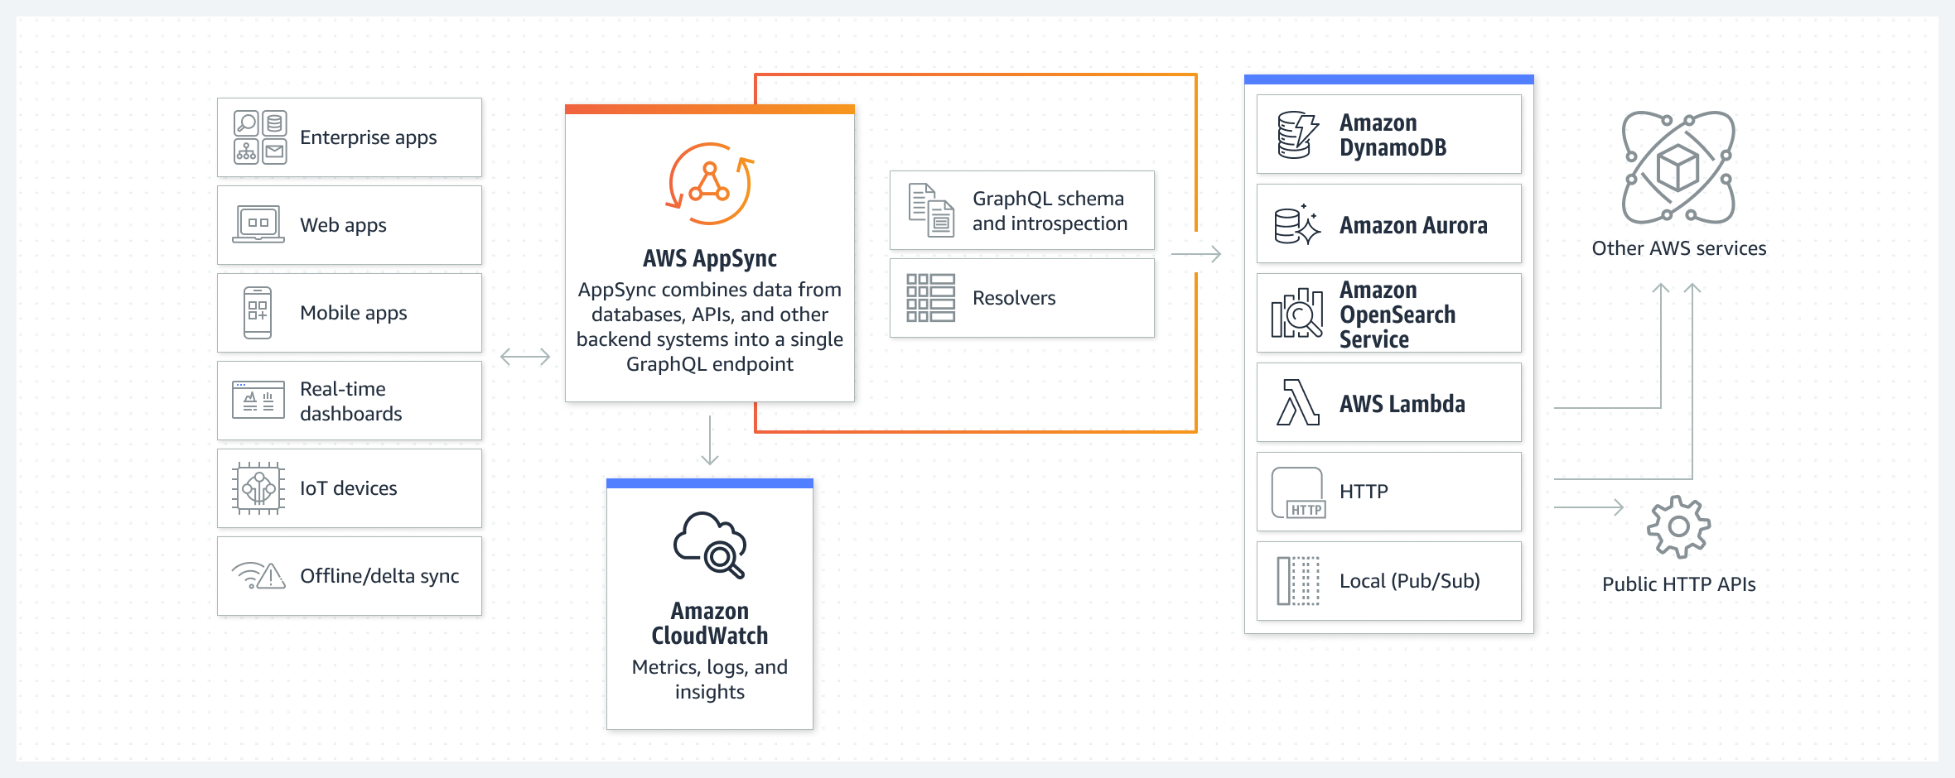
AWS AppSync
AWS AppSync creates serverless GraphQL and Pub/Sub APIs that simplify application development through a single endpoint to securely query, update, or publish data.

Slide 5
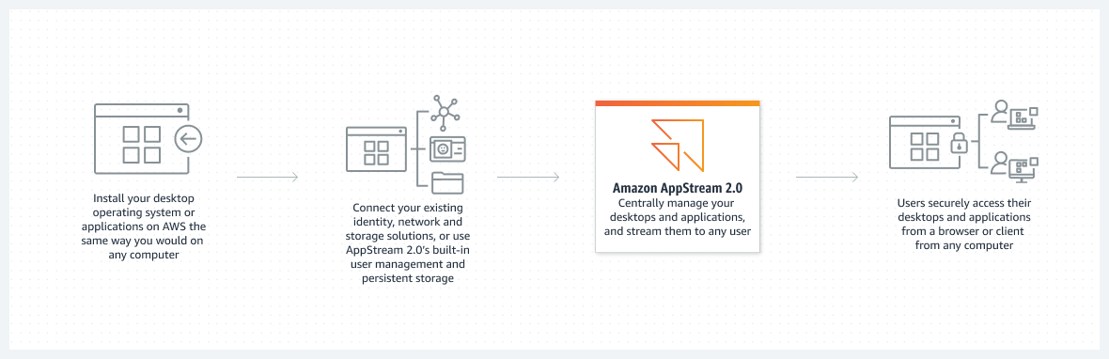
Amazon AppStream 2.0
Secure, reliable, and scalable application streaming and low-cost virtual desktop service

Slide 6
Amazon Workspaces
Amazon WorkSpaces enables you to provision virtual, cloud-based Microsoft Windows, Amazon Linux, or Ubuntu Linux desktops for your users, known as WorkSpaces.
WorkSpaces eliminates the need to procure and deploy hardware or install complex software.
You can quickly add or remove users as your needs change. Users can access their virtual desktops from multiple devices or web browsers.

Slide 7
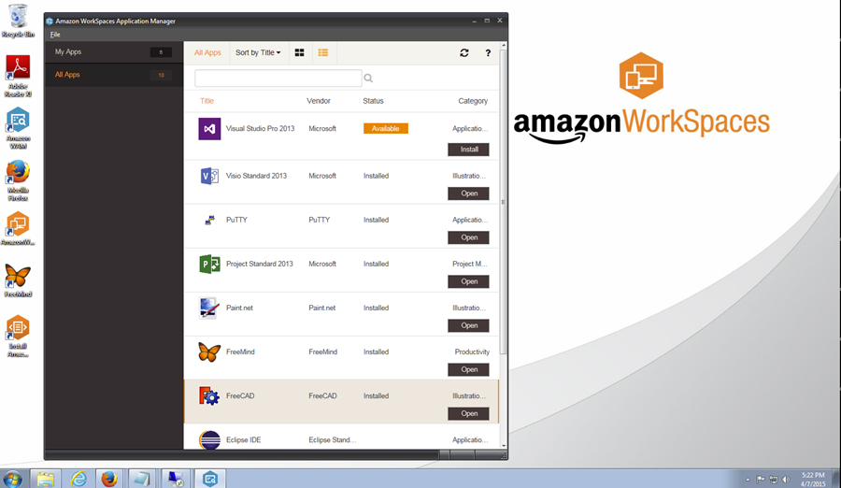
Amazon Workspaces

Slide 8
Muchas Gracias

